Slide 1
Kubernetes

Slide 2
STEP 5 – Creating mysql service
Pods are for ephemeral (short period). Every time when the pod is created it will have a different IP address. The WordPress application should know its IP to connect to the DB.
The exact purpose of the Kubernetes is to offer the IP address that is decoupled from that pod and never changes if the DB container is also ephemeral (short period)
To define Mysql service create a new yaml file named mysql-service.yaml.
After creating the file, we will execute a command to create actual service and then verify that service

Slide 3
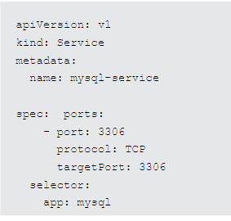

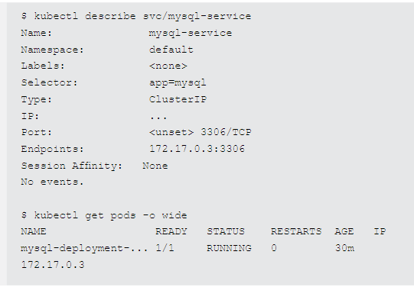
Content for creating the file, executing and verifying
create a new file
From the output we can understand that the service is correctly mapped which mean IP address for the service aligns with the IP address for the MySQL Pod.
Command to create the actual service execute
verify that the service is created and correctly mapped

Slide 4
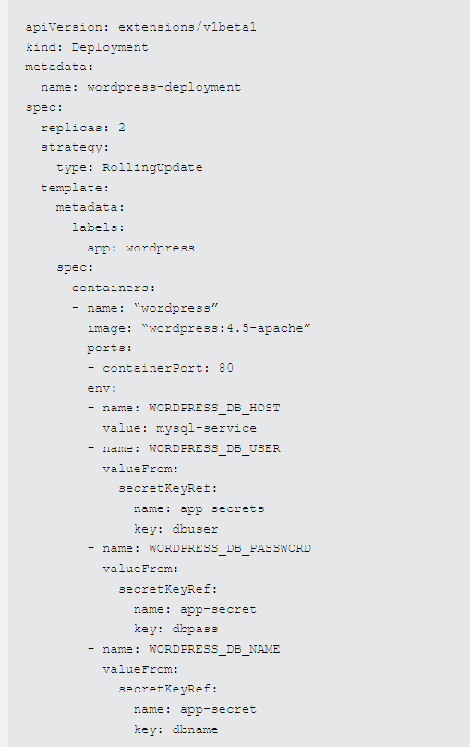
Step6 – deploy wordpress
To define a deployment for WordPress, create a new file, wordpress-deployment.yaml, with the following content:

Slide 5

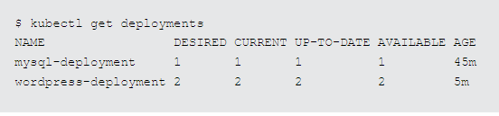
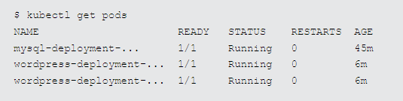
To create the actual deployment, execute the following command:
Verify the deployment:
Get a list of created pods:

Slide 6
These are some other commands we use
This executes an interactive shell within that pod
$ kubectl exec -it wordpress-deployment-... Bash
This display the entries in that particular host
root@wordpress# getent hosts mysql-service
You must be in root directory to list all the entries.
This command filters out the DB name, db user name, db pwd, and db host which was configured in wp=config.php file
root@wordpress# grep -i db /var/www/html/wp-config.php

Slide 7
STEP 7. CREATE A SERVICE FOR WORDPRESS
In this step we expose the WordPress application to external users. we expose a port on the node running our application, and forward it to port 80 of our container.
To define a service for the WordPress application, create a new file, wordpress-service.yaml then create actual service and verify its status.

Slide 8
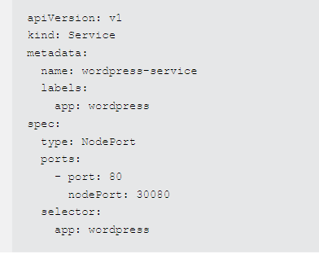

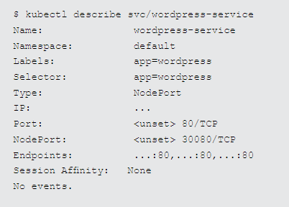
Creating new file
Execute actual service
Verify status

Slide 9
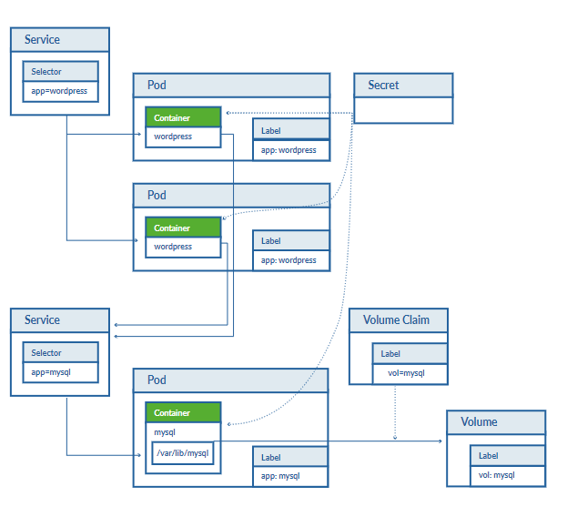
STEP 8. TEST THE WORDPRESS APPLICATION
Building blocks

Slide 10
DIY CLUSTER CONSIDERATIONS
High Availabilty
For example, kubelet talks to an external load-balancer rather than directly to clients; if the entire node fails, traffic can be load balanced to the node with corresponding pods. Finally, the master controller can fail, or one of its services can die. We need to replicate the master controller and its components for a Highly Available environment
Security
Direct access to cluster nodes (either physical or through SSH) should be restricted. Selectively grant users permissions according to their business needs and consider separating network traffic that is not related
Scale
Kubernetes allows for adding and removing nodes dynamically.

Slide 11
Stratoscale symphony
Four steps we use
Simple Creation
Admins can create private clusters via intuitive GUI or API.
Ongoing Monitoring
Easily monitor cluster health and usage.
Minimal Learning Curve
Leverage Kubernetes GUI and maintain existing practices.
Multi-Tenancy
Kubernetes is transformed to offer a true multi-tenant service.
USING KUBECTL CLI
FOR SINGLE-CLICK MANAGEMENT OF KUBERNETES CLUSTERS
Admins can leverage KubeCtl CLI or Symphony’s intuitive GUI to create Kubernetes clusters and easily monitor cluster health and usage.

Slide 12
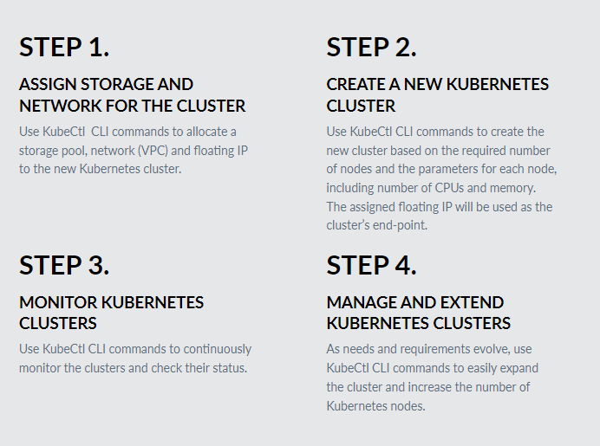
This simple example demonstrates how you can leverage the agility and simplicity of cloud method-ologies within your on-prem environment.

Slide 13
Redhat openshift

Slide 14
OpenShift - Overview
It is a cloud development Platform as a Service (PaaS) hosted by Red Hat used to create, test, and run applications, and finally deploy them on cloud.
It is capable of managing applications written in different languages, such as Node.js, Ruby, Python, Perl, and Java
It comes with various concepts of virtualization as its abstraction layer. The underlying concept behind OpenShift is based on virtualization.

Slide 15
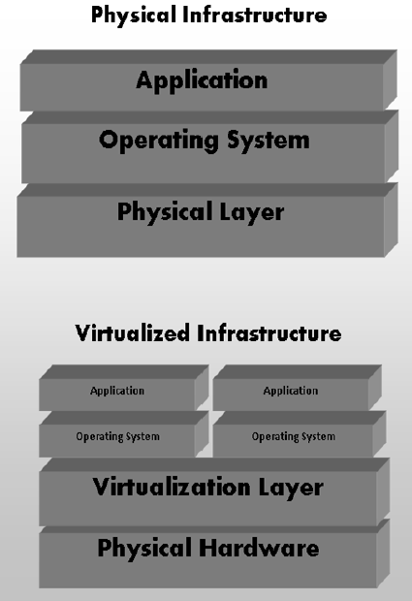
Virtualization
It can be defined as the creation of a virtual system rather than physical or actual version of anything starting from system, storage, or an operating system
The main goal is to make IT infrastructure more scalable and reliable.
It can be described as a technology in which any application or operating system is abstracted from its actual physical layer.
the concept of virtualization is popular as most of the system and application running do not require the use of the underlying hardware.

Slide 16
Types of Virtualization
Application Virtualization : The application is abstracted from the underlying operating system. The application can be run in isolation without being dependent on the operating system underneath.
Desktop Virtualization : This method is used to reduce the workstation load in which one can access the desktop remotely. A classic example is VDI.
Data Virtualization : It is a method of abstracting and getting away from traditional method of data and data management.
Server Virtualization : All server-related resources are virtualized which includes the physical server, process, and operating system.
Storage Virtualization : server-related resources are virtualized which includes the physical server, process, and operating system.
Network Virtualization : All available network resources are combined by splitting up the available bandwidth and channels, each of which is independent of each other.

Slide 17
Types of Services
Software as a Service (SaaS) :
With SaaS, one has the least worry about the underlying infrastructure.
The user just has to sign up for the services and start using it.
One drawback is, customization is minimal.
Most common example is Gmail.
Platform as a Service (PaaS) :
It can be considered as a middle layer between SaaS and IaaS.
These environments are designed in such a way that they can satisfy all the development needs, right from having a web application server with a database.
Infrastructure as a Service (IaaS) :
The service provider provides hardware level virtual machines with some pre-defined virtual hardware configuration.
The main drawback of having IaaS after a long procedure of setup and investment is that, one is still responsible for installing and maintaining the operating system.

Slide 18
Why OpenShift?
OpenShift provides a common platform for enterprise units to host their applications on cloud without worrying about the underlying operating system.
Its very easy to use, develop, and deploy applications on cloud.
One of the key features is, it provides managed hardware and network resources for all kinds of development and testing. With OpenShift, PaaS developer has the freedom to design their required environment with specifications.
OpenShift provides different kind of service level agreement when it comes to service plans.
Free : It is limited to 3 gears with 1GB space for each.
Bronze : It has 3 gears and expands upto 16 with 1GB space per gear.
Silver : It has 16 gear plan of bronze but has a storage capacity of 6GB with no additional cost.

Slide 19
OpenShift - Types
OpenShift came into existence from its base named OpenShift V2, which was mainly based on the concept of gear and cartridges, where each component has its specifications starting from machine creation till application deployment, right from building to deploying the application.
Cartridges : They were the focal point of building a new application starting from the type of application the environment requires to run them.
Application : These simply refer to the application or any integration application that will get deployed and run on OpenShift environment.
OpenShift Online : It is a pubic PaaS as a service hosted on AWS.
Gears : It can be defined as the bear metal machine or server with certain specifications regarding the resources, memory, and CPU.
OpenShift Origin : This was the community addition or open source version of OpenShift.
OpenShift Enterprise : This is the hardened version of OpenShift with ISV and vendor licenses.

Slide 20
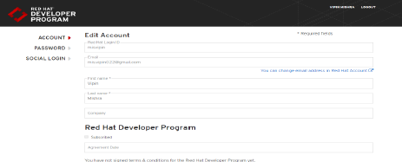
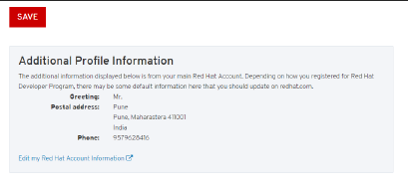
OpenShift Online
Setting Up Account :
Step 1 : Go to browser and visit the site https://manage.openshift.com/
Step 2 : If you have a Red Hat account, login to OpenShift account using the Red Hat login ID and password.
Step 3 : If you do not have a Red Hat account login, then sign up for OpenShift online service. After logging in you will see the following page.
Later Red Hat will show some basic account details as shown.

Slide 21
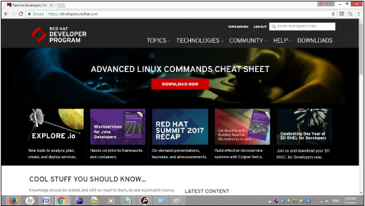
OpenShift Online
Setting Up Account :
Finally, when you are logged in, you will see the following page.

Slide 22
OpenShift Container Platform
OpenShift container platform is an enterprise platform which helps multiple teams such as development and IT operations team to build and deploy containerized infrastructure.
All the containers built in OpenShift uses a very reliable Docker containerization technology, which can be deployed on any data center of publically hosted cloud platforms.
It is the core concept of application containers powered by Docker, where orchestration and administration is managed by Kubernetes.
OpenShift brings Docker and Kubernetes together to the enterprise level. It is a container platform software for enterprise units to deploy and manage applicants in an infrastructure of own choice.
For example, hosting OpenShift instances on AWS instances.

Slide 23
OpenShift Dedicated
This gives the end user a true sense of multi-cloud offering, where they can use OpenShift on any cloud which satisfies their needs.
This gives the end user a true sense of multi-cloud offering, where they can use OpenShift on any cloud which satisfies their needs.
Features of OpenShift Dedicated
Extensible and Open: This is built on the open concept of Docker and deployed on cloud because of which it is can expend itself as and when required.
Orchestration: Orchestration and cluster management is supported using Kubernetes which came into offering with OpenShift version 3.
Portability: As it is built using Docker, the applications running on Docker can easily be shipped from one place to the other.
Automation: This version of OpenShift is enabled with the feature of source code management, build automation, and deployment automation.

Slide 24
OpenShift- Architecture
OpenShift is a layered system wherein each layer is tightly bound with the other layer using Kubernetes and Docker cluster.
The architecture of OpenShift is designed in such a way that it can support and manage Docker containers, which are hosted on top of all the layers using Kubernetes. Unlike the earlier version of OpenShift V2, the new version of OpenShift V3 supports containerized infrastructure.
In this model, Docker helps in creation of lightweight Linux-based containers and Kubernetes supports the task of orchestrating and managing containers on multiple hosts.

Slide 25
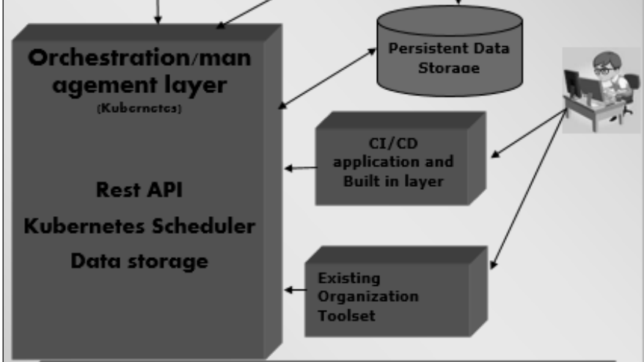

Slide 26
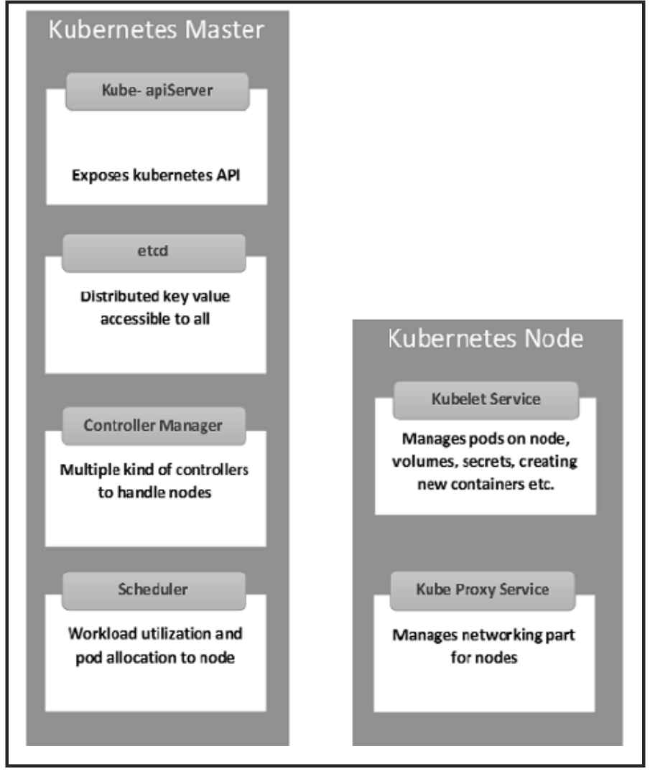
Components of OpenShift

Slide 27
Kubernetes Master Machine Components
Etcd: It stores the configuration information, which can be used by each of the nodes in the cluster
API Server: Kubernetes is an API server which provides all the operation on cluster using the API. API server implements an interface which means different tools and libraries can readily communicate with it.
Controller Manager: This component is responsible for most of the collectors that regulate the state of the cluster and perform a task. It can be considered as a daemon which runs in a non-terminating loop and is responsible for collecting and sending information to API server.
Scheduler: It is a key component of Kubernetes master. It is a service in master which is responsible for distributing the workload. It is responsible for tracking the utilization of working load on cluster nodes and then placing the workload on which resources are available and accepting the workload.

Slide 28
Kubernetes Node Components
Docker: The first requirement of each node is Docker which helps in running the encapsulated application containers in a relatively isolated but lightweight operating environment.
Kubelet Service: This is a small service in each node, which is responsible for relaying information to and from the control plane service. It interacts with etcd store to read the configuration details and Wright values.
Kubernetes Proxy Service: This is a proxy service which runs on each node and helps in making the services available to the external host. It helps in forwarding the request to correct containers. Kubernetes Proxy Service is capable of carrying out primitive load balancing.

Slide 29
OpenShift - Environment Setup
System Requirement
In order to set up enterprise OpenShift, one needs to have an active Red Hat account. As OpenShift works on Kubernetes master and node architecture, we need to set up both of them on separate machines, wherein one machine acts as a master and other works on the node. In order to set up both, there are minimum system requirements

Slide 30
Master Machine Configuration
· A base machine hosted either on physical, virtual, or on any of the cloud environment.
· At least Linux 7 with the required packages on that instance.
· 2 CPU core.
· At least 8 GB RAM.
· 30 GB of internal hard disk memory.

Slide 31
Node Machine Configuration
• Physical or virtual base image as given for the master machine.
• At least Linux 7 on the machine.
• Docker installed with not below than 1.6 version.
• 1 CPU core.
• 8 GB RAM.
• 15 GB hard disk for hosting images and 15 GB for storing images.

Slide 32
Step by Step Guide to OpenShift Setup
Step 1: First install Linux on both the machines, where the Linux 7 should be the least version. This can be done using the following commands if one has an active Red Hat subscription.
# subscription-manager repos --disable="*"
# subscription-manager repos --enable="rhel-7-server-rpms"
# subscription-manager repos --enable="rhel-7-server-extras-rpms"
# subscription-manager repos --enable="rhel-7-server-optional-rpms"
# subscription-manager repos --enable="rhel-7-server-ose-3.0-rpms"
# yum install wget git net-tools bind-utils iptables-services bridge-utils
# yum install wget git net-tools bind-utils iptables-services bridge-utils
# yum install python-virtualenv
# yum install gcc
# yum install httpd-tools

Slide 33
Step 2: Configure Docker so that it should allow insecure communication on the local network only. For this, edit the Docker file inside /etc/sysconfig. If the file is not present then you need to create it manually.
# vi /etc/sysconfig/docker
OPTIONS=--selinux-enabled --insecure-registry 192.168.122.0/24
Step 3: Generate keys on the master machine and then copy the id_rsa.pub key to the authorized key file of the node machine, which can be done using the following command.
# ssh-keygen
# ssh-copy-id -i .ssh/id_rsa.pub root@ose3-node.test.com
Step 4: From the master machine, run the following curl command.
# sh <(curl -s https://install.openshift.com/ose)
The above command will put the setup in place for OSV3. The next step would be to configure OpenShift V3 on the machine.
Once we have the setup ready, then we need to start with the actual configuration of OSV3 on the machines. This setup is very specific to test the environment for actual production, we have LDAP and other things in place

Slide 34
Step 5: On the master machine, configure the following code located under /etc/openshift/master/master-config.yaml
# vi /etc/openshift/master/master-config.yaml identityProviders
name: my_htpasswd_provider challenge: true
login: true provider
apiVersion: v1
kind: HTPasswdPasswordIdentityProvider
file: /root/users.htpasswd
routingConfig:
subdomain: testing.com
Next, create a standard user for default administration.
# htpasswd -c /root/users.htpasswd admin

Slide 35
Step 6: As OpenShift uses Docker registry for configuring images, we need to configure Docker registry. This is used for creating and storing the Docker images after build.
Create a directory on the OpenShift node machine using the following command.
# mkdir /images
Next, login to the master machine using the default admin credentials, which gets created while setting up the registry.
# oc login
Username: system:admin
Switch to the default created project.
# oc project default

Slide 36
Step 7: Create a Docker Registry.
#echo '{"kind":"ServiceAccount","apiVersion":"v1","metadata":{"name":"registry"}}' | oc create -f -
Edit the user privileges.
#oc edit scc privileged
users:
- system:serviceaccount:openshift-infra:build-controller
- system:serviceaccount:default:registr
Create and edit the image registry.
#oadm registry --service-account=registry -- config=/etc/openshift/master/admin.kubeconfig -- credentials=/etc/openshift/master/openshift-registry.kubeconfig -- images='registry.access.redhat.com/openshift3/ose-${component}:${version}' -- mount-host=/images

Slide 37
Step 8: Create a default routing.
By default, OpenShift uses OpenVswitch as software network.
Use the following command to create a default routing.
This is used for load balancing and proxy routing. The router is similar to the Docker registry and also runs in a registry.
# echo '{"kind":"ServiceAccount","apiVersion":"v1","metadata":{"name":"router"}}' | oc create -f
Next, edit the privileges of the user.
#oc edit scc privileged
users:
- system:serviceaccount:openshift-infra:build-controller
- system:serviceaccount:default:registry
- system:serviceaccount:default:router
#oadm router router-1 --replicas=1 -- credentials='/etc/openshift/master/openshift-router.kubeconfig' -- images='registry.access.redhat.com/openshift3/ose-${component}:${version}'

Slide 38
Step 9: Configure the DNS.
In order to handle URL request, OpenShift needs a working DNS environment.
This DNS configuration is required to create a wild card, which is required to create DNS wild card that points to a router.
# yum install bind-utils bind
# systemctl start named
# systemctl enable named
vi /etc/named.conf
options {listen-on port 53 { 10.123.55.111; };
forwarders {
10.38.55.13;
};
zone "lab.com" IN {
type master;
file "/var/named/dynamic/test.com.zone";
allow-update { none; };

Slide 39
Step 10:
The final step would be to set up github server on OpenShift V3 master machine, which is optional. This can be done easily using the following sequence of commands.
#yum install curl openssh-server
#systemctl enable sshd
# systemctl start sshd
# firewall-cmd --permanent --add-service=http
# systemctl reload firewalld
#curl https://packages.gitlab.com/install/repositories/gitlab/gitlab-
#yum install gitlab-ce
# gitlab-ctl reconfigure

Slide 40
OpenShift - Basic Concept
Containers and Images
Pods and Services
Builds and Streams

Slide 41
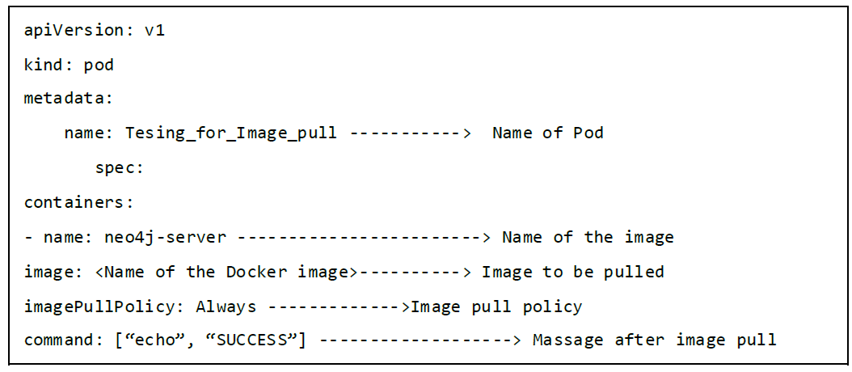
Images
These are the basic building blocks of OpenShift, which are formed out of Docker images.
In each pod on OpenShift, the cluster has its own images running inside it.
When we configure a pod, we have a field which will get pooled from the registry. This configuration file will pull the image and deploy it on the cluster node.
In order to pull and create an image out of it, run the following command. OC is the client to communicate with OpenShift environment after login

Slide 42
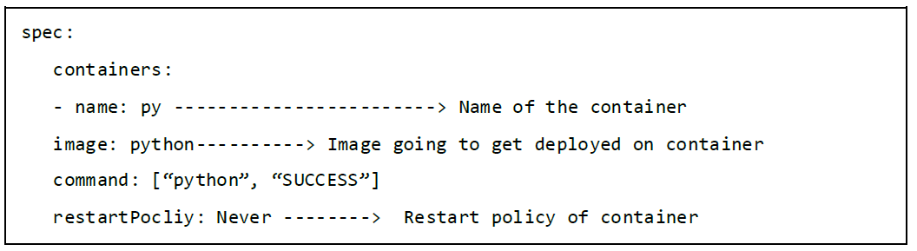
Container
This gets created when the Docker image gets deployed on the OpenShift cluster.
While defining any configuration, we define the container section in the configuration file.
One container can have multiple images running inside and all the containers running on cluster node are managed by OpenShift Kubernetes.

Slide 43
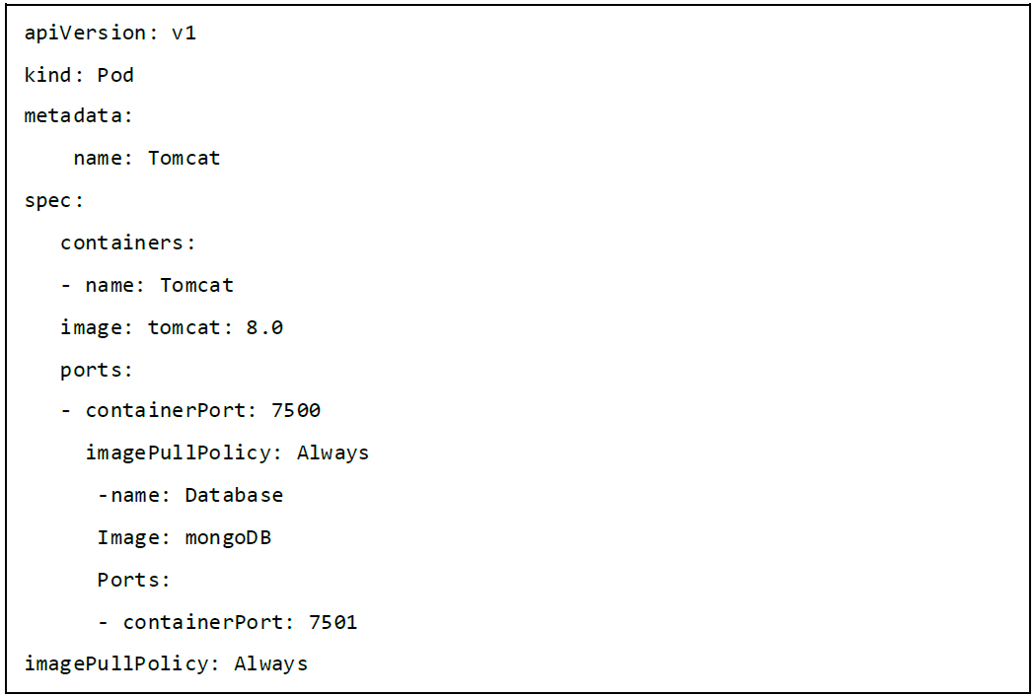
a container having multiple images running inside it.

Slide 44
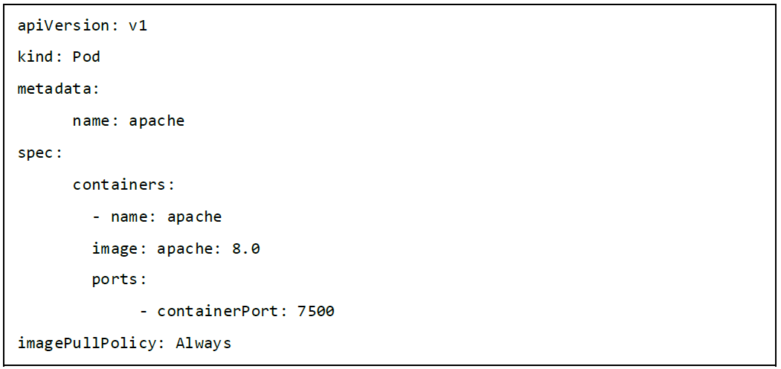
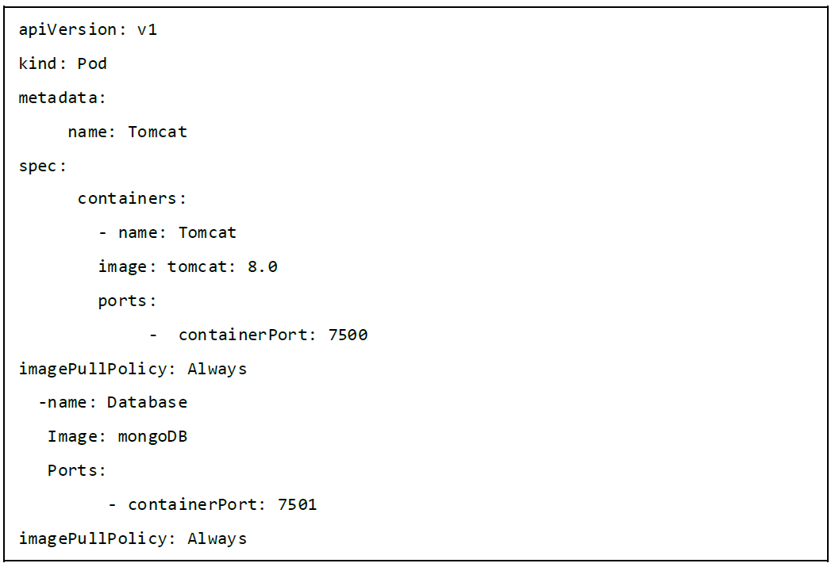
Pods Pod can be defined as a collection of container and its storage inside a node of OpenShift (Kubernetes) cluster
Single Container Pod:
Multi-Container Pod:
Single-container pods are those in which we have only one container running inside it.
Multi-container pods are those in which we have more than one container running inside it.

Slide 45
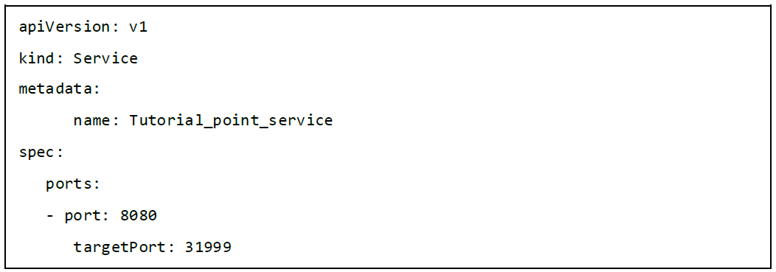
Service
A Kubernetes service serves as an internal load balancer. It identifies a set of replicated pods in order to proxy the connections it receives to them.
It’s an abstracted layer on top of the pod, which provides a single IP and DNS name through which pods can be accessed.
Service helps in managing the load balancing configuration and to scale the pod very easily

Slide 46
Builds
In OpenShift, build is a process of transforming images into containers. It is the processing which converts the source code to an image.
This build process works on pre-defined strategy of building source code to image.
The build processes multiple strategies and sources.
Build Strategies
Source to Image: This is basically a tool, which helps in building reproducible images.
Docker Build: This is the process in which the images are built using Docker file by running simple Docker build command.
Custom Build: These are the builds which are used for creating base Docker images

Slide 47
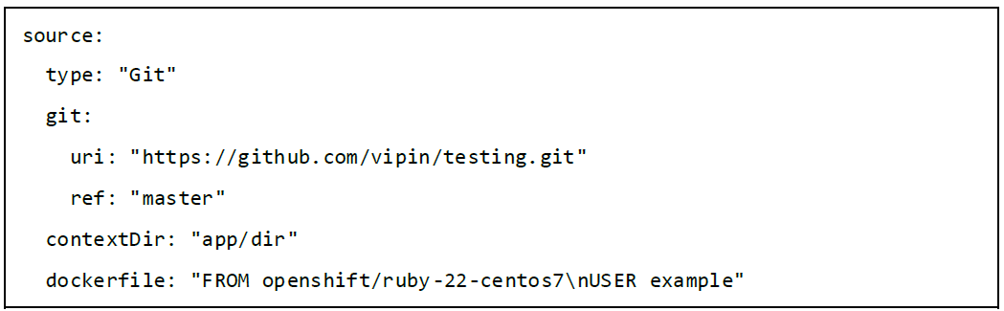
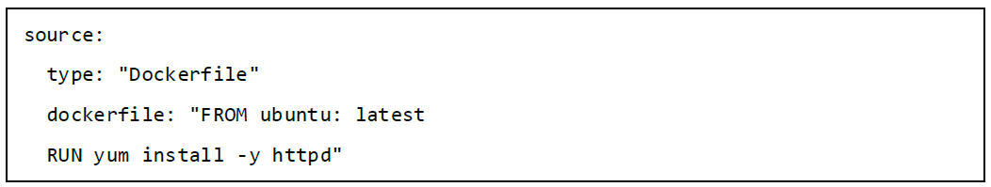
Build Sources
Git:
Dockerfile:
This source is used when the git repository is used for building images.
The Dockerfile is used as an input in the configuration file.

Slide 48
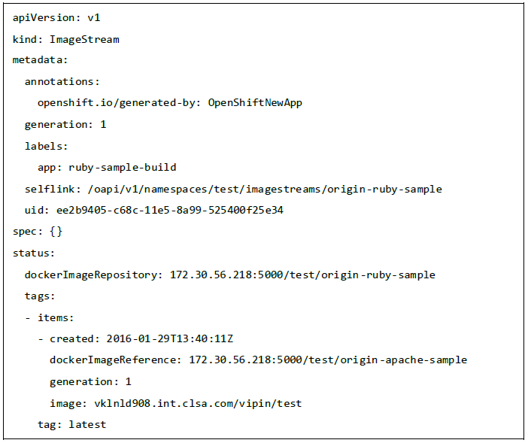
Image Streams
Image streams are created after pulling the images.
The advantage of an image stream is that it looks for updates on the new version of an image.
Image streams can automatically perform an action when a new image is created.
All the builds and deployments can watch for image action and perform an action accordingly.

Slide 49
THANK YOU

